Slide 1
Cse 316
Full-Stack
Web Security

Slide 2

What things do we need to be able to do?
Accounts Management
register user, login user, logout user
enforce password verification
associate lists and other things with specific users
User Authentication
verify user is who they say they are
Set Rules so:
everything sent between client and server is encrypted (SSL)
only hashed passwords are stored on server (bcrypt)
when a user logs in they are issued a site-specific token (JWT)
every time a user asks for something they must present the token

Slide 3
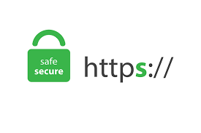

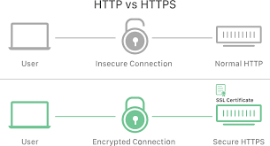
https is better than http
Why?
everything sent back and forth is encrypted
https is also called http over SSL
done through official server SSL certificates
Allows clients/servers to send:
user information
passwords, credit cards, etc.
tokens

Slide 4
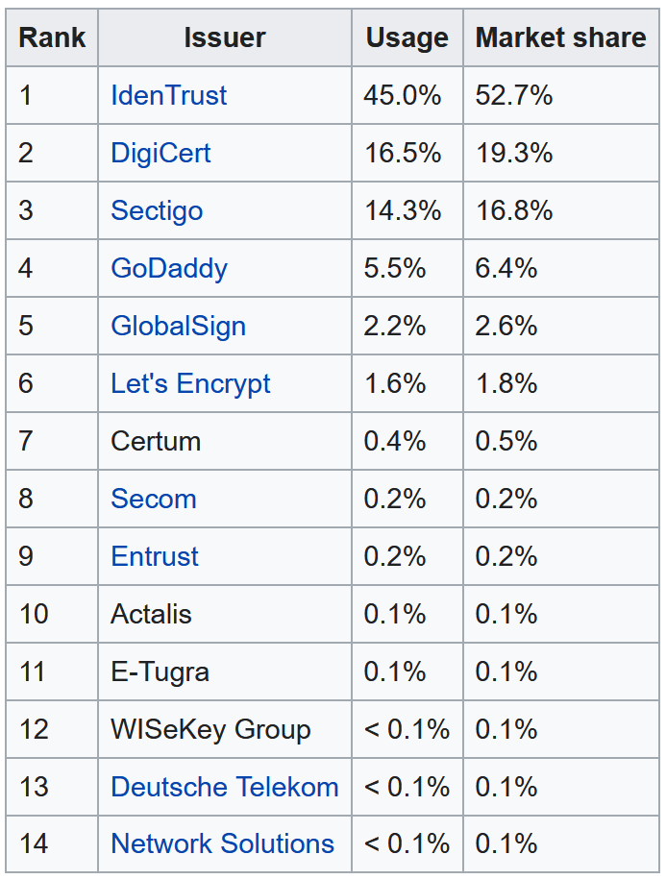
Certificate Authorities
Who are they?
mixture of private and non-profit entities
Ex: cloud services now provide them
for those hosting apps on their sites
Google, AWS, Cloudfare

Slide 5
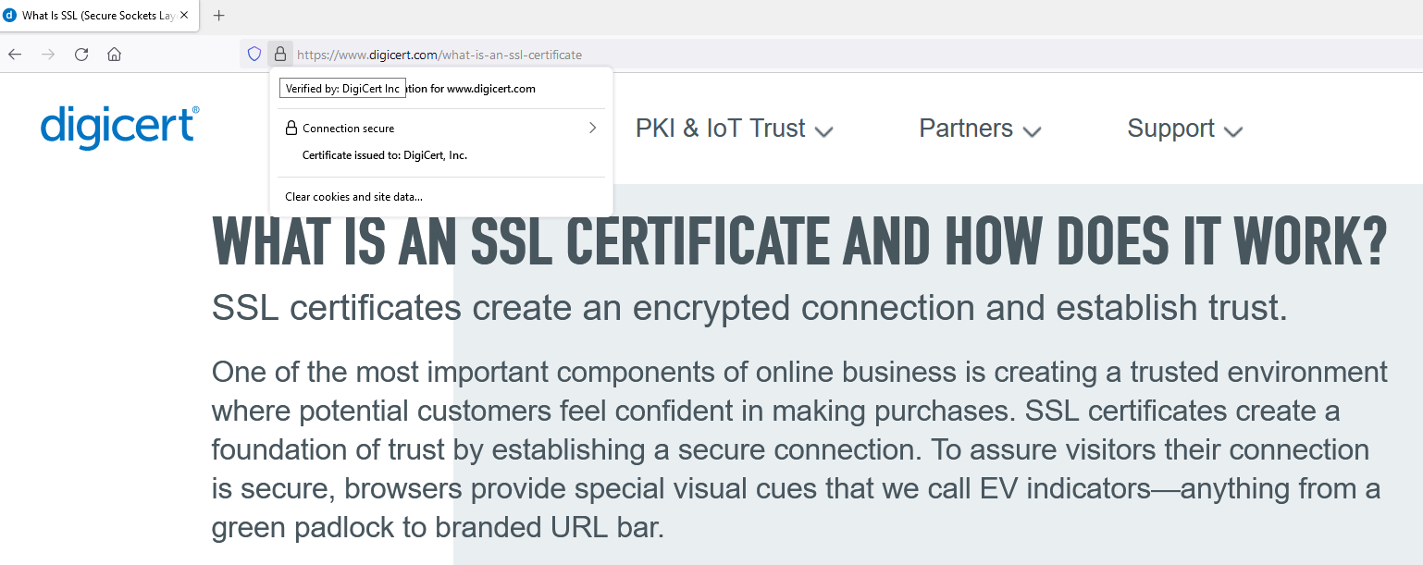
Browsers Help us know which sites have proper certificates

Slide 6
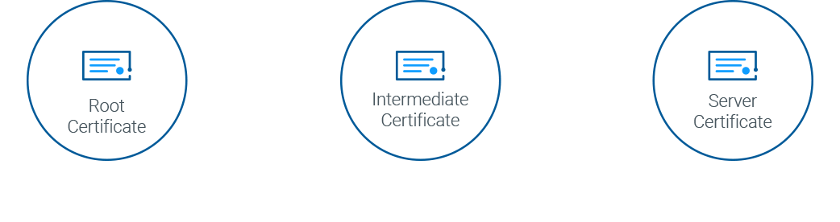
Secure Socket Layer (SSL)
SSL Certificates
subject is the identity of the website owner
public/private key pairs
To setup on your server:
1) Create a Certificate Signing Request (CSR) on your server
creates a public/private key pair on your server
2) Send CSR data file to Certificate Authority (CA)
3) CA registers and sends back your certificate
4) Install certificate on your server
5) Install an intermediate certificate to establish credibility of your SSL certificate

Slide 7
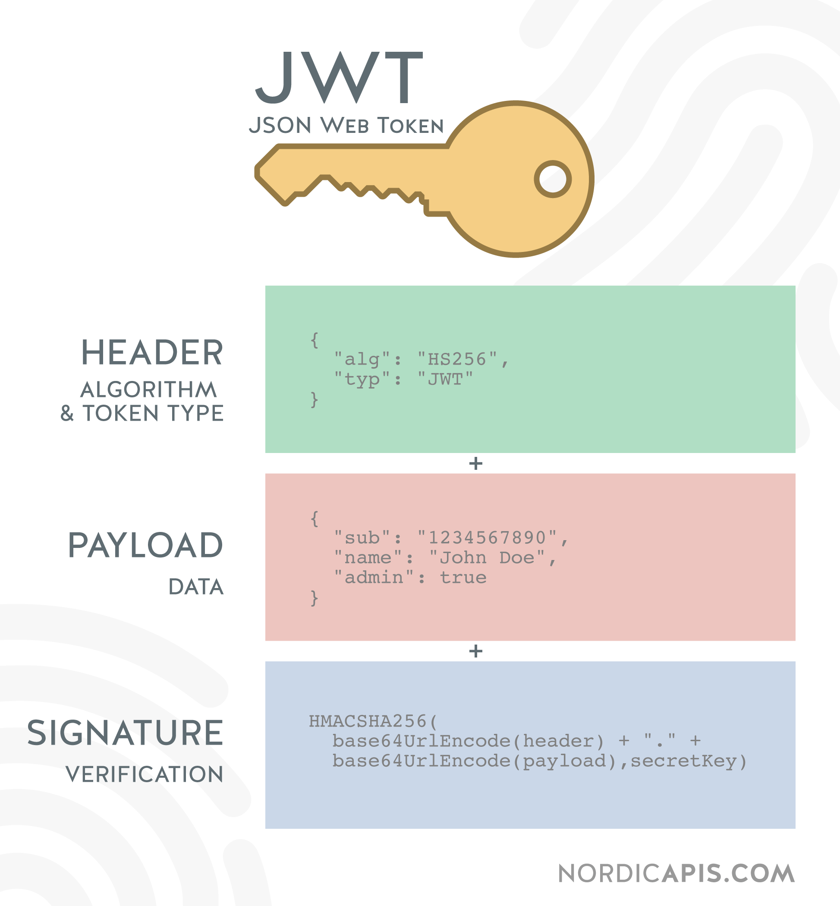
Authentication Strategy
When a user logs in, they are issues an authentication token
we’ll use JSON Web Tokens (JWTs), an open standard
Where should client store it?
local storage? can be accessed (and hacked) via JavaScript
httpOnly cookies
JWT is signed using server secret password
Every time user wants to do anything, client presents token
then verified by server before handling request

Slide 8
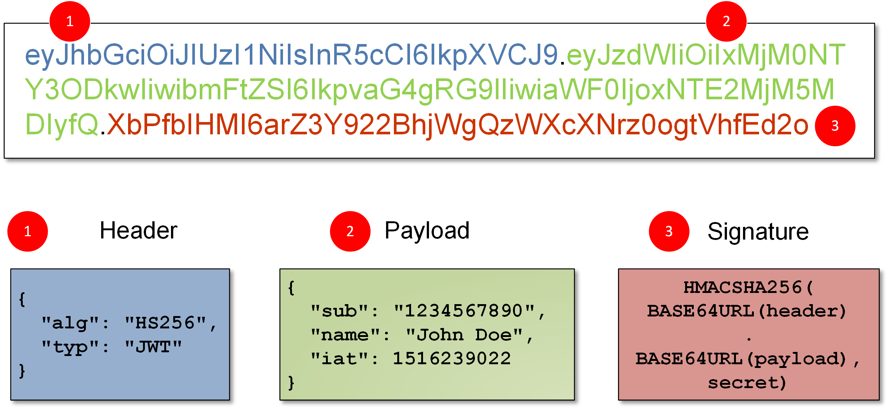
So why are JWTs Useful?
Authorization
after login
each subsequent request will include the JWT
allows access to routes, services, and resources permitted with that token
Information Exchange
signed via public key encryption

Slide 9
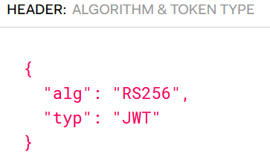
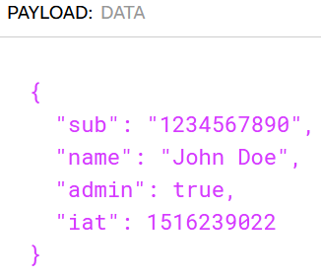
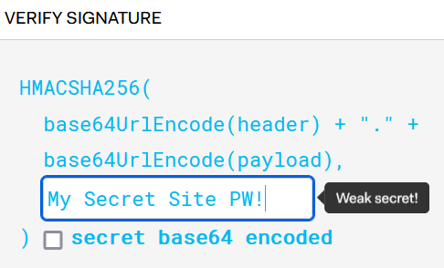
JWT structure
Header
specifies signing algorithm (like RSA)
Payload
claims (issuer, expiration, subject, audience, etc.)
Signature
encrypted, used to verify JWT wasn’t tampered with
contains our site’s SECRET password

Slide 10
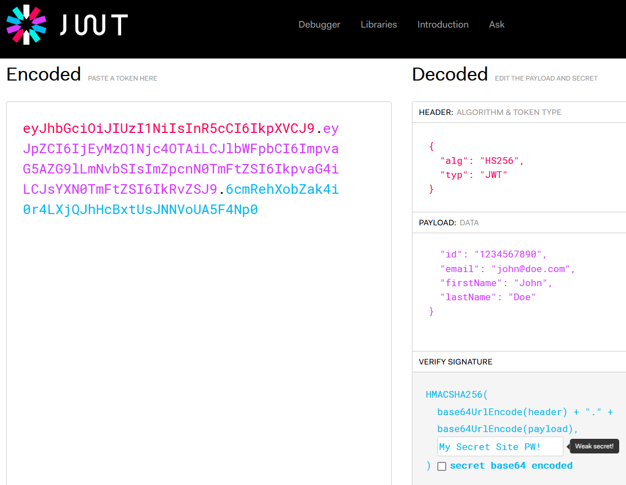

Slide 11
How do JWTs work?
A JWT is then three Base-64 URL strings separated by dots
XXX.YYY.ZZZ
In authentication, when a user successfully logs in, server:
makes and signs JWT (i.e. the token)
JWT is returned to user in response (we’re do so via httpOnly cookie)
browser stores token in cookie until expiration date
With each subsequent request, browser sends the JWT:
JWT is then applied to authentication strategy
i.e. server verifies token to get user info to check if they have permission

Slide 12
jwt – signing a token (done at login)
const jwt = require("jsonwebtoken")
…
const token = jwt.sign({ userId: user._id }, process.env.JWT_SECRET);
await res.cookie("token", token, {
httpOnly: true, secure: true, sameSite: "none"
}).status(200).json({
success: true,
user: {
email: savedUser.email
}
}).send();

Slide 13
jwt – verify a token (done with post-login requests)
try {
const token = req.cookies.token;
if (!token) {
return res.status(401).json({errorMessage: "Unauthorized"})
}
const verified = jwt.verify(token, process.env.JWT_SECRET)
// IF AN EXCEPTION ISN’T THROWN THEN THAT MEANS THE USER HAS BEEN VERIFIED
// WE CAN NOW LET THEM DO WHAT THEY WANT LIKE CRUD OPERATIONS BUT WE MUST
// ALSO MAKE SURE THEY HAVE PERMISSION TO USE THE RESOURCES THEY WANT TO USE
} catch (err) {
return res.status(401).json({errorMessage: "Unauthorized"})
}

Slide 14
Setting Up Accounts Management
Back-End
a User Schema
password salting and hashing
hashed password comparisons
routes for account actions
controllers for account actions
authentication via our middleware
Front-End
front-end controls to select register/login/logout
front-end forms for register/login
front-end route navigation
payload formats for requests
payload formats for responses

Slide 15
Creating a User Schema
const mongoose = require('mongoose')
const Schema = mongoose.Schema
const UserSchema = new Schema(
{
email: { type: String, required: true },
passwordHash: { type: String, required: true }
},
{ timestamps: true },
)
module.exports = mongoose.model('User', UserSchema)

Slide 16
bcrypt – when registering or changing a password
const saltRounds = 10;
const salt = await bcrypt.genSalt(saltRounds);
// hash employs Blowfish algorithm
const passwordHash = await bcrypt.hash(password, salt);
// now save the hash to the user
const newUser = new User({
email, passwordHash
});
const savedUser = await newUser.save();

Slide 17
bcrypt – when registering or changing a password
const passwordCorrect = await bcrypt
.compare(password, existingUser.passwordHash);
if (!passwordCorrect) {
return res
.status(401)
.json({
errorMessage: "Wrong email or password."
})
}

Slide 18
Setting Up Back-End Routes
router.post('/register', UserController.registerUser)
router.post('/login', UserController.loginUser)
router.get('/logout', UserController.logoutUser)
router.get('/loggedIn', UserController.getLoggedIn)

Slide 19
What should the registerUser controller do?
1) Get email/password/password2 from the request body
2) Make sure all necessary fields were provided, if not, send an error status with a message
3) Make sure the password is good enough, if not, send an error status with a message
4) Make sure both passwords are the same, if not, send an error status with a message
5) See if a user already exists with that email, if so, send an error status with a message
6) Salt and Hash password
7) Make and save new User in database
8) Send success status to user so they can login

Slide 20
What should the loginUser controller do?
1) Get email/password from the request body
2) Make sure all necessary fields were provided, if not, send an error status with a message
3) Get existing user for email, if doesn’t exist, send an error status with a message
4) Check hashed provided password against previously provided hashed password, if not the same, send error status with a message
6) Sign a JSON Web Token using site’s SECRET, and embed user id inside
7) Attach token to response in http-only cookie
8) Send success status to user and embed necessary user info

Slide 21
What should the logoutUser controller do?
1) Send the user a cookie response with an empty, expired token

Slide 22
Have our router send all requests through our auth middleware
const router = express.Router()
router.post('/top5list', auth.verify, Top5ListController.createTop5List)
router.put('/top5list/:id', auth.verify, Top5ListController.updateTop5List)
router.delete('/top5list/:id', auth.verify, Top5ListController.deleteTop5List)
router.get('/top5list/:id', auth.verify, Top5ListController.getTop5ListById)
router.get('/top5lists', auth.verify, Top5ListController.getTop5Lists)
router.get('/top5listpairs', auth.verify, Top5ListController.getTop5ListPairs)

Slide 23
Now Make our own Express auth Middleware
const jwt = require("jsonwebtoken")
function authManager() {
verify = function (req, res, next) {
const token = req.cookies.token;
const verified = jwt.verify(token, process.env.JWT_SECRET)
req.userId = verified.userId; // SEND ON THE USER INFO
// DO ADDITIONAL AUTHORIZATION CHECKS
next(); // NOW EXCECUTE CONTROLLER CODE (OR THE NEXT MIDDLEWARE)
}
}
return this;
}
const auth = authManager();
module.exports = auth;

Slide 24
We should also know how we may be attacked
Cyber Attack:
offensive action that targets computer information systems, infrastructures, computer networks or personal computer devices, using various methods to steal, alter or destroy data or information systems.
Common Techniques
Birthday attack
Cross-site scripting (XSS) attack
Denial-of-service (DoS)/Distributed denial-of-service (DDoS) attacks
Drive-by attack
Eavesdropping attack
Malware attack
Man-in-the-middle (MitM) attack
Password attack
Phishing and spear phishing attacks

Slide 25

Birthday Attack
Used against hash algorithms used to verify the integrity of a message, software, or digital signature
Attacker tries to produce similar hash to user
Why birthday?
How?
offline testing

Slide 26
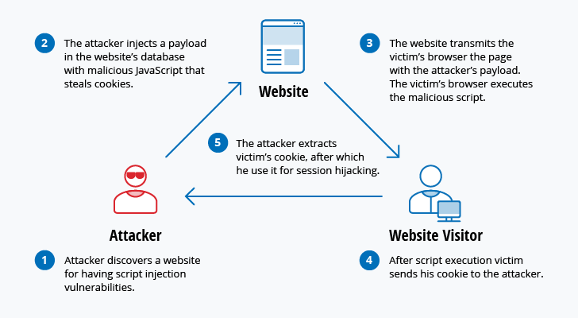
Cross-site Scripting Attack
XSS Attack
Use 3rd party resources to run scripts in victim’s browser
How?
inject malicious JavaScript into website’s database
SQL Injection Attack
server sends malicious code
seal cookies to enable session hijacking

Slide 27

Denial of Service Attack
Overwhelm a system’s resources so it can’t handle user requests
Doesn’t necessarily provide benefits to attackers
Many Types:
TCP SYN flood attack
Teardrop attack
Smurf attack
Ping of death attack
Botnets (i.e. zombie systems)

Slide 28
Drive-by Attack
Find a weak site
Plant malicious code into unsuspecting code (like PHP)
Malicious code may:
install malware on user machine
redirect victim to hacker site
Commonly associated with site/email popup windows

Slide 29
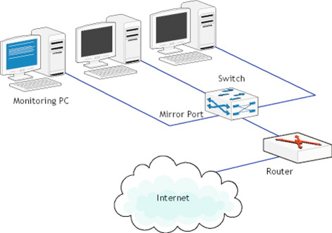
Eavesdropping Attack
Interception of network traffic
Use of data intercepted
Passive eavesdropping
like packet sniffing
Active eavesdropping
hacking an account
remember to use good security questions

Slide 30

Malware Attack
Unwanted software installed without your consent
Can attach itself to legitimate code and propogate
Can lurk in useful applications
Viruses, Trojans, Worms
Includes Ransomware

Slide 31
Man-in-the-middle Attack
Attacker hijacks a session between client & server
Substitutes is own IP address for client
How?
A client connects to a server.
The attacker’s computer gains control of the client.
The attacker’s computer disconnects the client from the server.
The attacker’s computer replaces the client’s IP address with its own IP address and spoofs the client’s sequence numbers.
The attacker’s computer continues dialog with the server and the server believes it is still communicating with the client

Slide 32
Password Attack
Use technology or otherwise
packet sniffing
hacking a user’s computer
learning about the user
Offline password cracking
brute force vs dictionary
Countermeasures:
2 factor authentication, security questions, account lockout

Slide 33

Phishing Attack
Sending emails that appear to be from trusted sources
Gain personal info or influence users
Get them to click on a link
leads to other malicious attacks
Spearfishing Attacks specifically target known parties

Slide 34
What is CORS?
Cross-origin Resource Sharing
Mechanism that allows restricted resources on a web page to be requested from another domain outside the domain from which the first resource was served
Issue for Ajax requests in particular
Why do we need to use a cors API?
allows servers to specify who and how resources are accessed

Slide 35
Some Web security rules of thumb
Do not store sensitive session data in Browser Storage
i.e. Local Storage or Web Storage
Do not store sensitive session data in Cookies
Do not store plaintext passwords
Do not transmit plaintext passwords
Beware of packet sniffers

Slide 36
MERN Stack Security Seems Complicated
Many little libraries to help
cors: cross-origin resource sharing
morgan: logging middleware for server to help with errors and monitor traffic
bcrypt: password hashing function employing Blowfish algorithm
PassportJS: open authentication
helmet: 12 middleware functions to set server security policy
xss-clean: sanitize user input from requests to prevent malicious code injection
express-mongo-sanitize: looks out for $where, again to prevent code injection
jsonwebtoken

Slide 37
Example: Using helmet to prevent clickjacking
app.use(helmet({
frameguard: {
action: 'deny'
}
}))
clickjacking?
tricking a user into clicking on something different from what they perceive
put transparent layer over real Web app
embedded scripts that appear to do something else but are malicious
embed scripts in clickjacked emails?

Slide 38
Resources
Top 10 Most Common Types of Cyber Attacks
https://blog.netwrix.com/2018/05/15/top-10-most-common-types-of-cyber-attacks/
Same Origin Policy
https://developer.mozilla.org/en-US/docs/Web/Security/Same-origin_policy
Securing MERN Stack Web Applications using Passport
https://www.djamware.com/post/5a90c37980aca7059c14297a/securing-mern-stack-web-application-using-passport
Note: this example is for a RESTful back-end

